Slide 1
Surface Heat treatment of materials

Slide 2
Heat treatment
Heat treatment is the process of heating and cooling metals to change their microstructure and to bring out the physical and mechanical characteristics that make metals more desirable.
The most common reasons metals undergo heat treatment are to improve their strength, hardness, toughness, ductility and corrosion resistance.
Surface hardening is the process of hardening the surface of a metal object while allowing the metal deeper underneath to remain soft, thus forming a thin layer of harder metal (called the "case") at the surface.
For example components like turbine shaft, gears, spindle, automotive components and axle need to have a hard surface but a soft core.

Slide 3

An overview of important heat treatments
HEAT TREATMENT
BULK
SURFACE
ANNEALING
NORMALIZING
HARDENING
&
TEMPERING
THERMO-
CHEMICAL
THERMAL
Full Annealing
Carburizing
MARTEMPERING
Flame
Recrystallization Annealing
Induction
Nitriding
Stress Relief Annealing
AUSTEMPERING
LASER
Carbo-nitriding
Spheroidization Annealing
Electron Beam

Slide 4
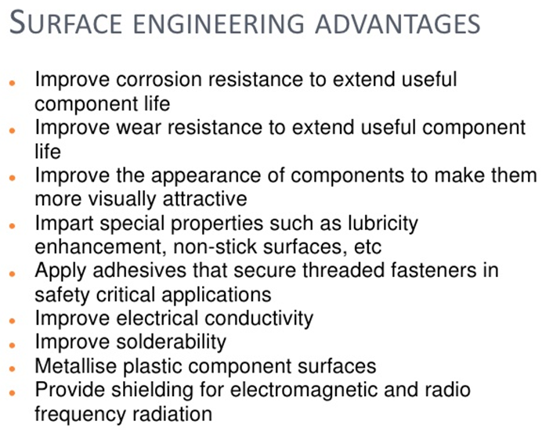

Slide 5
Ranges of temperature where Annealing, Normalizing and Spheroidization treatment are carried out for hypo- and hyper-eutectoid steels.
Normalizing Heat Treatment process is heating a steel above the critical temperature, holding for a period of time long enough for transformation to occur, and air cooling.
Full Annealing
910°C
A_{cm}
Normalization
Normalization
A₃
723°C
Full Annealing
A₁
Spheroidization
Stress Relief Annealing
↑
T
Recrystallization Annealing
Wt% C
0.8 %

Slide 6
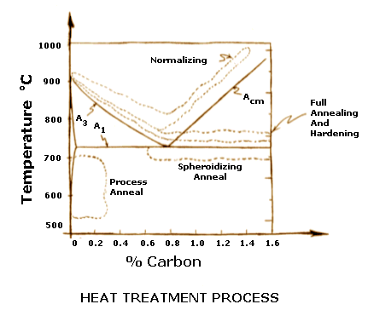

Slide 7
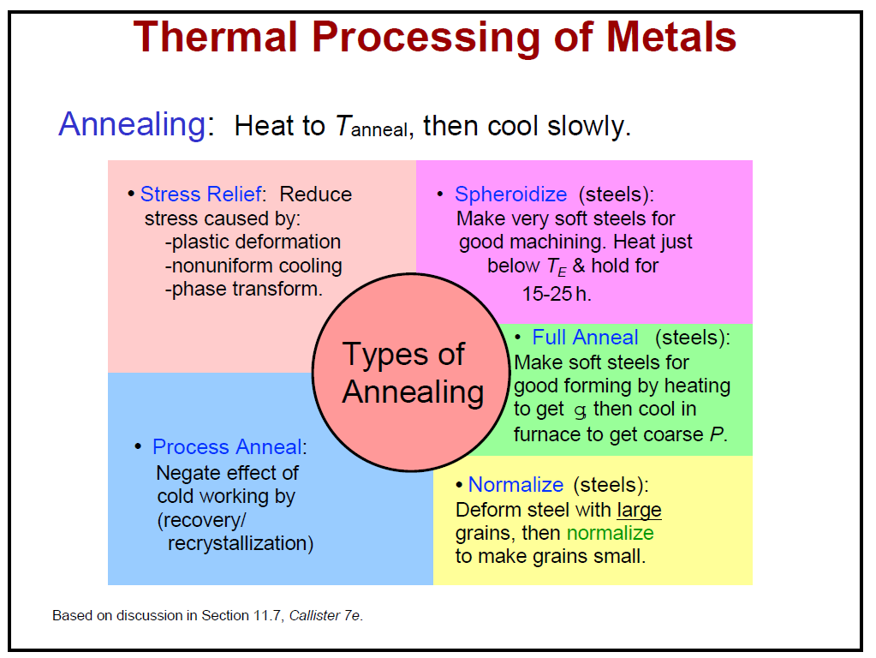

Slide 8
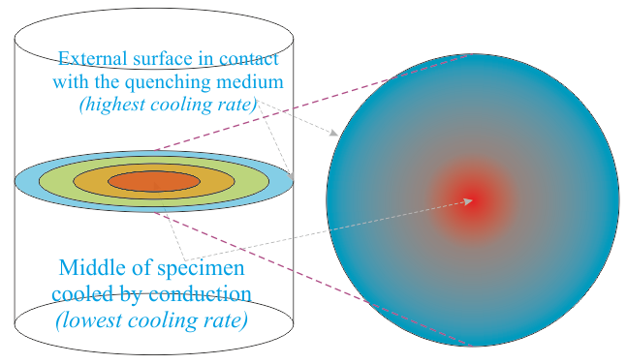
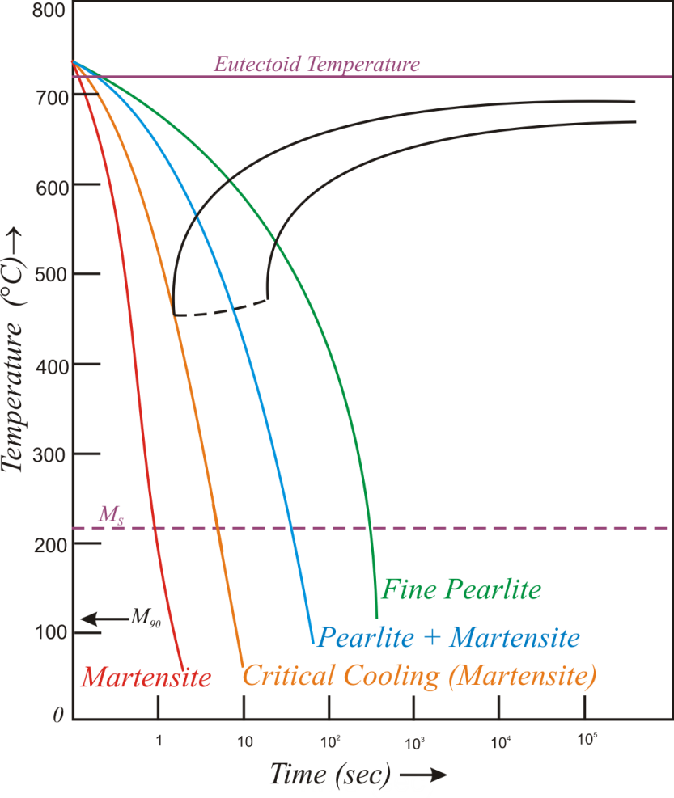
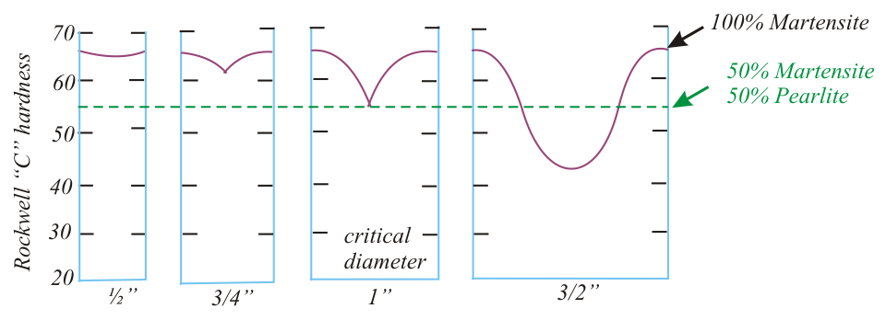
Through hardening of the sample
The surface is affected by the quenching medium and experiences the best possible cooling rate. The interior of the sample is cooled by conduction through the (hot) sample and hence experiences a lower cooling rate. This implies that different parts of the same sample follow different cooling curves on a CCT diagram and give rise to different microstructures.
This gives to a varying hardness from centre to circumference. Critical diameter (d_{c}) is that diameter, which can be through hardened (i.e. we obtain 50% Martensite and 50% pearlite at the centre of the sample).
Schematic showing variation in cooling rate from surface to interior leading to different microstructures

Slide 9
Quenching media
Brine (water and salt solution)
Water
Oil
Air
Turn off furnace

Slide 10
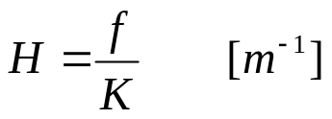
Severity of quench values of some typical quenching conditions
Before we proceed further we note that we have a variety of quenching media at our disposal, with varying degrees of cooling effect. The severity of quench is indicated by the ‘H’ factor (defined below), with an ideal quench having a H-value of ∞.
Severity of Quench as indicated by the heat transfer equivalent H
f → heat transfer factor
K → Thermal conductivity
Note that apart from the nature of the quenching medium, the vigorousness of the shake determines the severity of the quench. When a hot solid is put into a liquid medium, gas bubbles form on the surface of the solid (interface with medium). As gas has a poor conductivity the quenching rate is reduced. Providing agitation (shaking the solid in the liquid) helps in bringing the liquid medium in direct contact with the solid; thus improving the heat transfer (and the cooling rate). The H value/index compares the relative ability of various media (gases and liquids) to cool a hot solid. Ideal quench is a conceptual idea with a heat transfer factor of ∞ (⇒ H = ∞).
Process | Variable | H
Air | No agitation | 0.02
Oil quench | No agitation | 0.2
" | Slight agitation | 0.35
" | Good agitation | 0.5
" | Vigorous agitation | 0.7
Water quench | No agitation | 1.0
" | Vigorous agitation | 1.5
Brine quench (saturated Salt water) | No agitation | 2.0
" | Vigorous agitation | 5.0
Ideal quench |  | ∞
Increasing severity of quench

Slide 11
Surface hardening: why & how?
Components like gear, shaft or spindle need a hard / wear resistant surface but a soft / tough core.
Section size of such components is often too large to be uniformly hardened even on severe quenching.
More over the time lag between the transformations at the surface and the core results in an unfavorable tensile residual stress at the surface.
Recall the general thumb rule that the region that transforms later is likely to have compressive residual stress.
The surface is likely to transform first in steel having the same composition all through its section.
Therefore surface would have residual tensile stress. Depending on its magnitude it may lead to cracking or distortion.
The presence of residual tensile stress is also harmful as it would reduce fatigue life of critical components like turbine shaft or landing gear of an aircraft.
The purpose of surface hardening is to develop a hard surface with compressive residual stress, to improve its wear resistance, to increase its fatigue life and to avoid susceptibility to distortion and cracking.

Slide 12
There are several other ways the strength or the hardness of the surface can be increased without adversely affecting the toughness of the core.
Some of the most common techniques are as follows:
Induction hardening
Case carburizing + case hardening
Nitriding
Shot peening
Hard facing, coating or surface alloying
Formation of Martensite is primarily responsible for the development of very high strength in steel.
However you need to cool a component made of steel very fast to get martensite

Slide 13
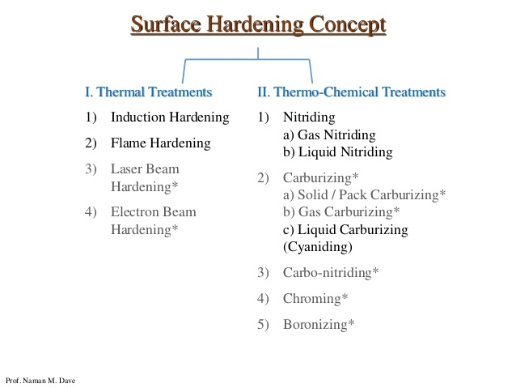

Slide 14
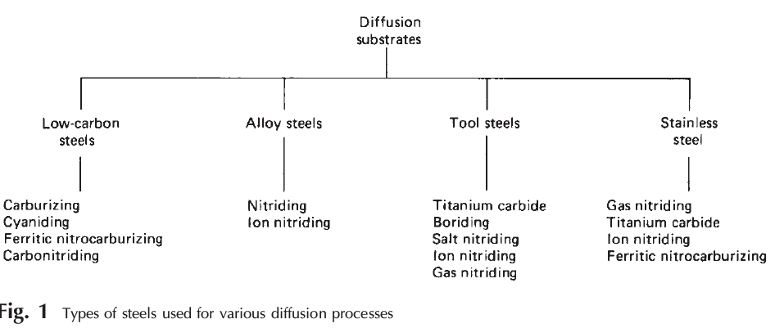

Slide 15
Engineering methods for surface hardening
Layer additions | Substrate treatment
Hard-facing Fusion hard-facing Thermal spray Coatings Electrochemical plating Chemical vapor deposition (electroless plating) Thin films (physical vapor deposition, Sputtering, ion plating) Ion mixing | Diffusion methods Carburizing Nitriding Carbonitriding Nitrocarburizing Boriding Titanium-carbon diffusion Toyota diffusion process Selective hardening methods Flame hardening Induction hardening Laser hardening Electron beam hardening Ion implantation Selective carburizing and nitriding

Slide 16
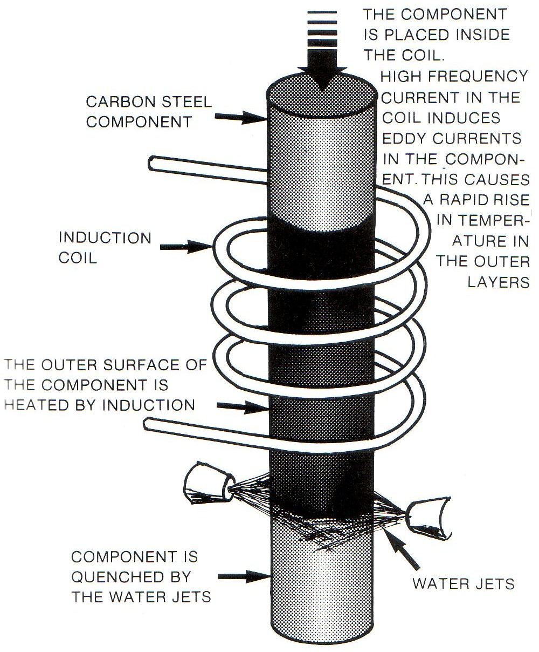
Induction hardening
Induced eddy currents heat the surface of the steel very quickly and is quickly followed by jets of water to quench the component.
A hard outer layer is created with a soft core. The slideways on a lathe are induction hardened.

Slide 17
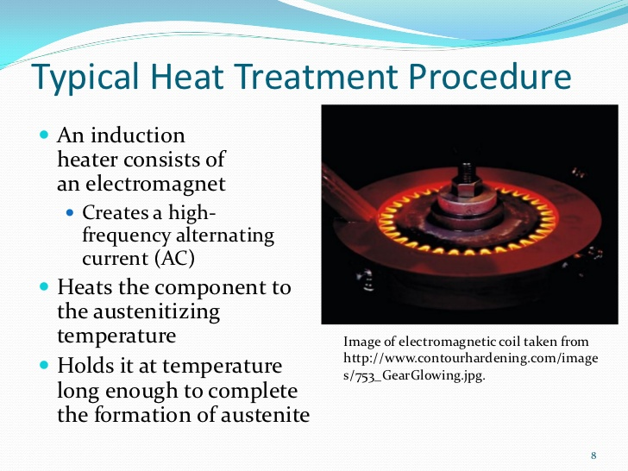

Slide 18
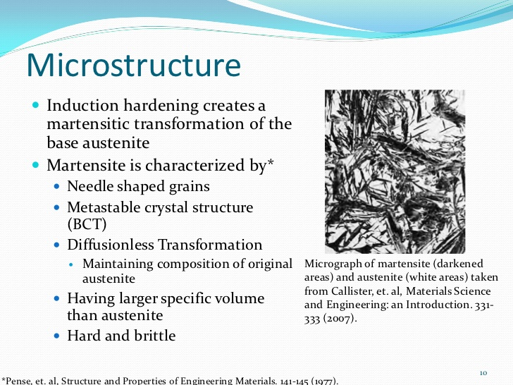

Slide 19
Induction hardening is very effective for surface hardening of plain carbon steel having 0.35‐0.70%C.
The salient features of induction hardening are as follows:
• Heat the surface to a temperature above A3 (austenitic region)
• Core does not get heated : the structure remains unaltered
• Surface converts to martensite on quenching.
• Fast heating & short hold time: needs higher austenization temperature
• Martensite forms in fine inhomogeneous grains of austenite
• Applicable to carbon steels (0.35 – 0.7C)
• Little distortion & good surface finish

Slide 20
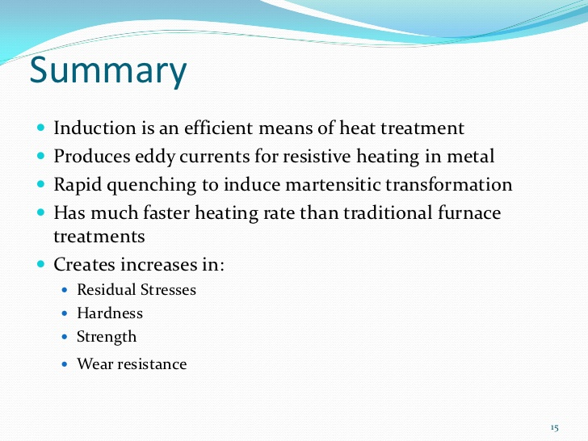
Once the process is complete the microstructure of the surface gets transformed into martensite while that at its core remains unaltered.

Slide 21
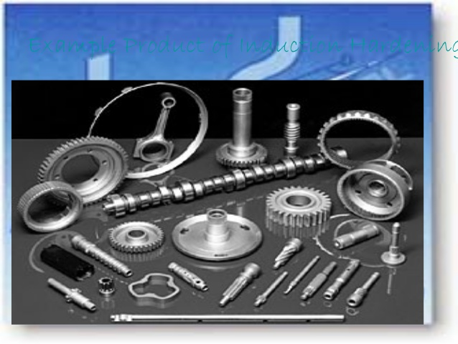

Slide 22
Carburizing
Carburizing, also referred to as Case Hardening, is a heat treatment process that produces a surface which is resistant to wear while maintaining toughness and strength of the core.
This treatment is applied to low carbon steel parts after machining as well as high alloy steel bearings, gears and other components.
Carburizing increases strength and wear resistance by diffusing carbon into the surface of the steel creating a case while retaining a substantially lesser hardness in the core. This treatment is applied to low carbon steels after machining.
Most carburizing is done by heating components in either a pit furnace, or sealed atmosphere furnace and introducing carburizing gases at temperature.
Gas carburizing allows for accurate control of both the process temperature and carburizing atmosphere (carbon potential).
Carburizing is a time/temperature process; the carburizing atmosphere is introduced into the furnace for the required time to ensure the correct depth of case.
The carbon potential of the gas can be lowered to permit diffusion, avoiding excess carbon in the surface layer.

Slide 23
Carburizing cannot be done in ferrite phase as it has very low solid solubility for carbon at room temperature. It is done in the Austenite region above 727°C in carbon rich atmosphere.
Types of carburizing
i. Pack carburizing
ii. Gas carburizing
iii. Liquid carburizing
For iron or steel with low carbon content, which has poor to no hardenability of its own, the case hardening process involves infusing additional carbon into the case.
Case hardening is usually done after the part has been formed into its final shape, but can also be done to increase the hardening element content of bars to be used.
Because hardened metal is usually more brittle than softer metal, through-hardening (that is, hardening the metal uniformly throughout the piece) is not always a suitable choice for applications where the metal part is subject to certain kinds of stress.
In such applications, case hardening can provide a part that will not fracture (because of the soft core that can absorb stresses without cracking) but also provides adequate wear resistance on the surface.

Slide 24
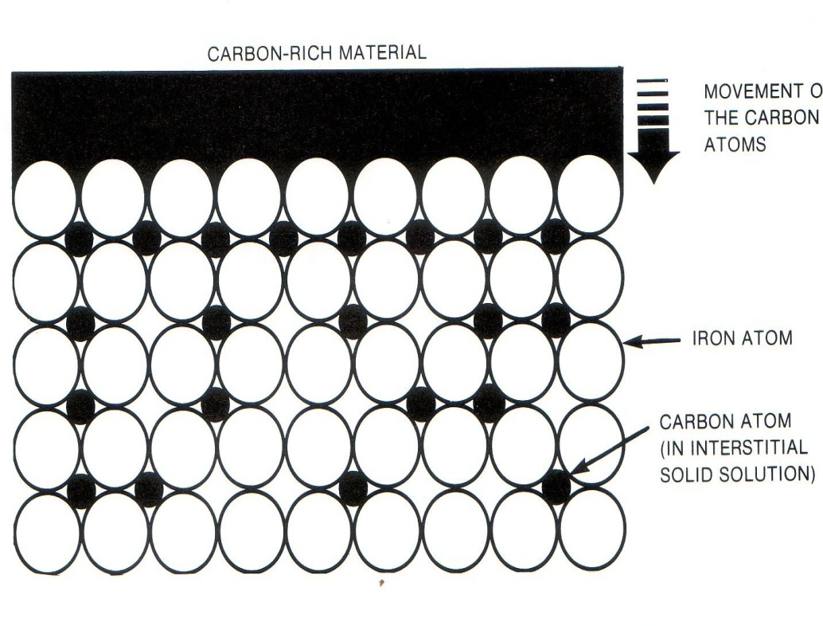
Pack carburizing
The component is packed surrounded by a carbon-rich compound and placed in the furnace at 900 degrees.
Over a period of time carbon will diffuse into the surface of the metal.
The longer left in the furnace, the greater the depth of hard carbon skin. Grain refining is necessary in order to prevent cracking.
A major limitation of pack carburizing is poor control over temperature & carburization depth.
On completion of the process the steel parts are cooled slowly. Direct quenching is not possible as the job is surrounded by carburizing mixture packed in a sealed box having high thermal mass.
This can be overcome by using gaseous or liquid carburizing medium.

Slide 25
Salt bath carburizing. A molten salt bath (sodium cyanide, sodium carbonate and sodium chloride) has the object immersed at 900 degrees for an hour giving a thin carbon case when quenched.
  NaCN + Na2CO3+NaCl
Gas carburizing. The object is placed in a sealed furnace with carbon monoxide allowing for fine control of the process.
Gas carburization is done by keeping the samples at the carburizing temperature for a specified time in a furnace having a mixture of carburizing and neutral gas. CH4 and CO are the most commonly used carburizing gas.
It is usually mixed with de‐carburizing (H2 and CO2) and neutral gases (N2).
This helps maintain a close control over carbon potential. It should be enough to maintain %C at in the range 1.0‐1.2% at the surface.
In the presence of Fe the carburizing gases decompose to produce nascent carbon that diffuses into steel.
CH4 = C (Fe) + 2H2
2CO = C (Fe) + CO2
It provides excellent control over the furnace temperature and atmosphere (carbon potential).
Samples after carburization can be directly quenched.

Slide 26
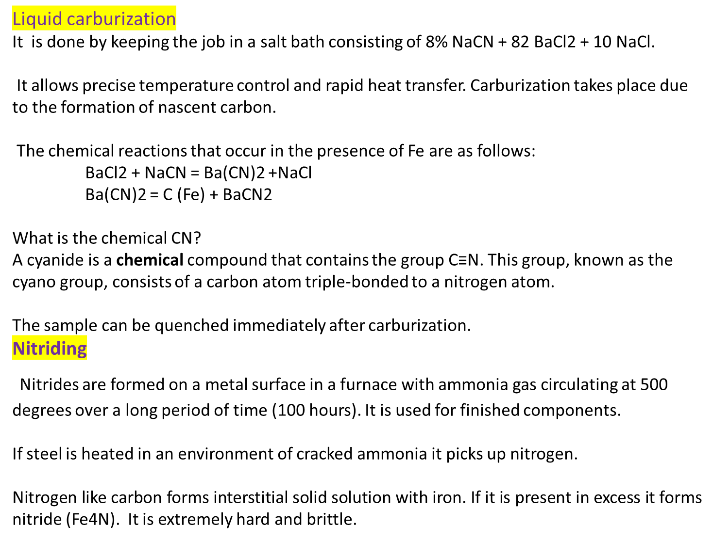

Slide 27
Nascent nitrogen that forms at the surface of steel as ammonia comes in contact with Fe.
This diffuses into iron lattice and form nitride as and when the amount of nitrogen in steel exceeds its solubility limit.
The presence of alloying elements having high affinity for nitrogen increases nitrogen pick up.
The formation of nitride within the matrix results in a substantial increase in the hardness of steel.
The preferred thickness of the hardened layer is around 20 micro meter.
The hardness of the nitride layer is usually in the range of 1000‐2000Hv.
Nitriding of steel is carried out only after it has been hardened and tempered. It is the last heat treatment given to steel.

Slide 28
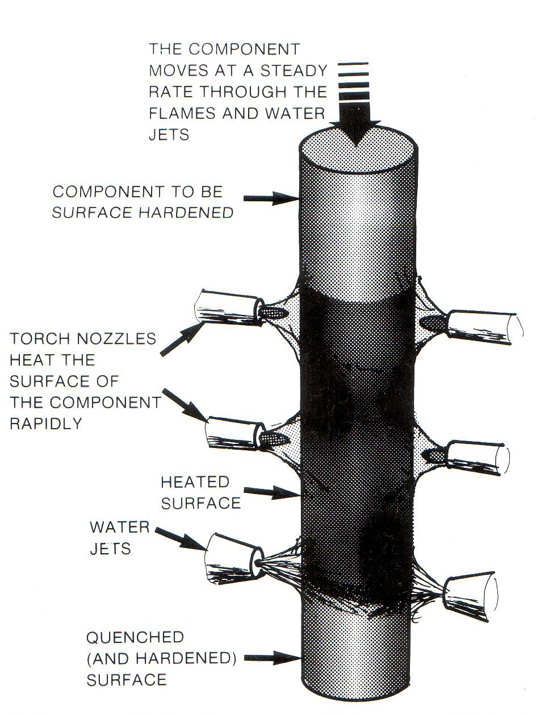
Flame hardening
Gas flames raise the temperature of the outer surface above the upper critical temp. The core will heat by conduction.
Water jets quench the component.

Slide 29
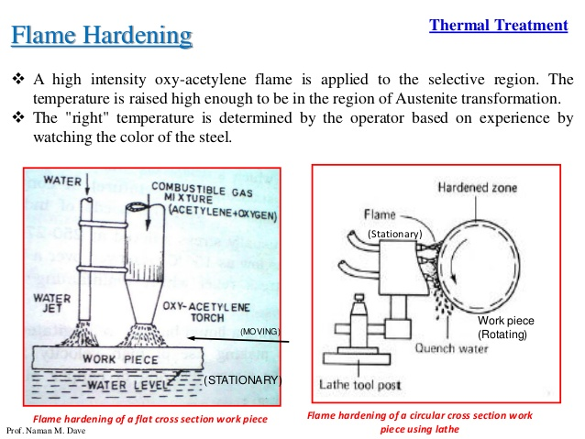

Slide 30
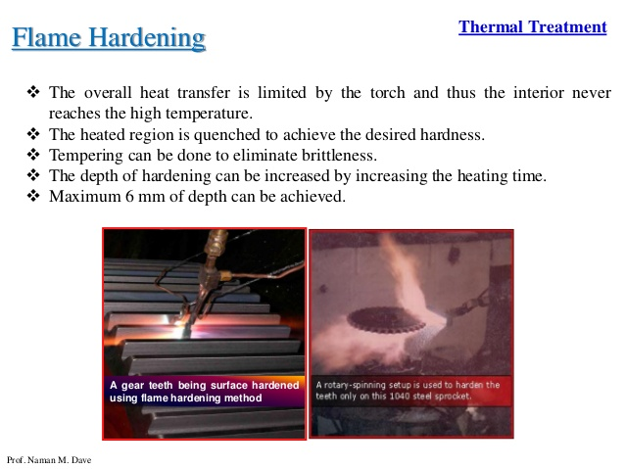

Slide 31
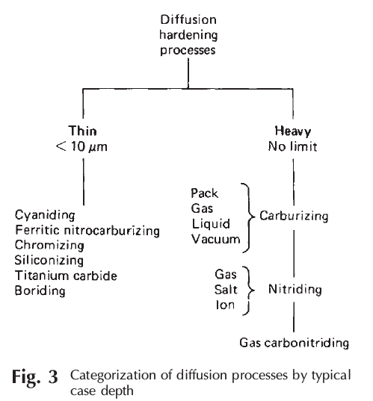

Slide 32
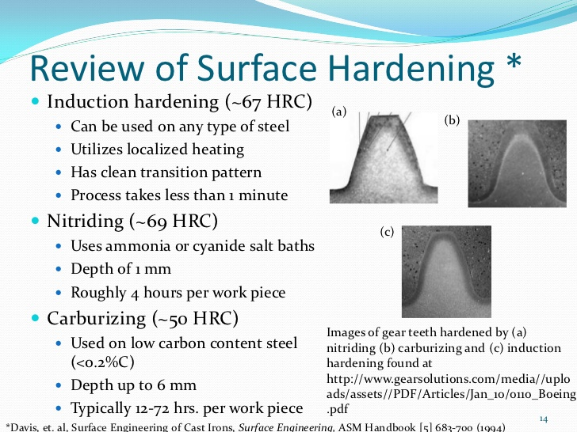

Slide 33
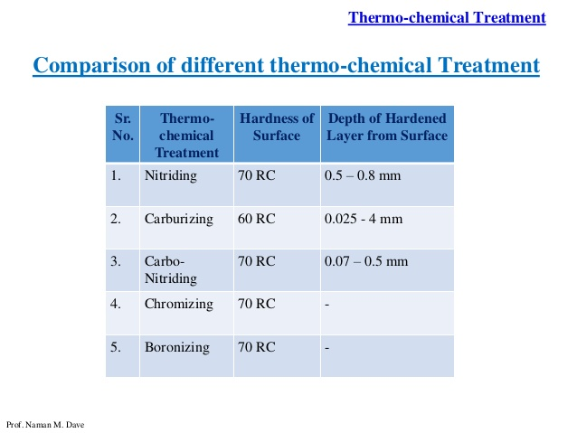

Slide 34
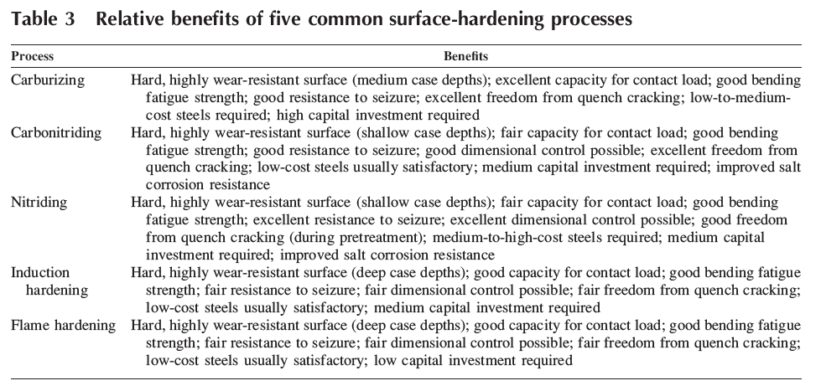

Slide 35
Vapor Deposition
Physical Vapor Deposition (PVD)
  Thermal PVD
  Sputter Deposition
  Ion plating
Chemical Vapor Deposition (CVD)

Slide 36
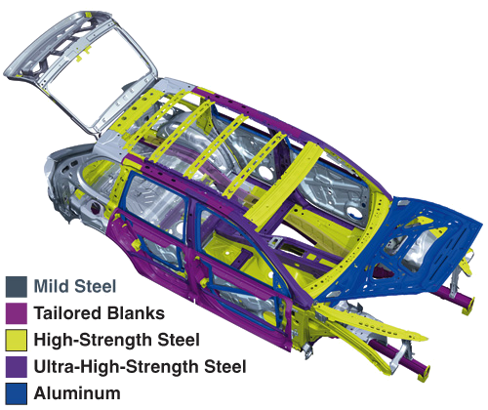
Ultra high strength steels
RG

Slide 37
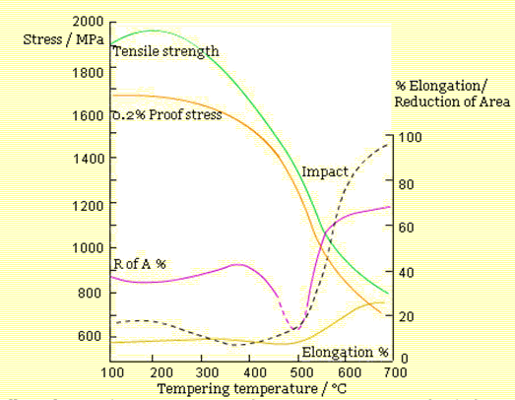
ULTRA HIGH STRENGTH STEELS
Introduction in
Conventional direct hardening steels are usually designed ranges of tensile strength, which in commercial practice ranges from 75 or 100 MPa. For example, 850-1100 MPa.
General effect of Tempering Temperature on the Room Temperature Mechanical Properties of Steels Initially Quenched to be Almost Completely Martensitic.
In commercial engineering applications, the tensile strength is usually limited to a maximum of 1250 MPa, with a few exceptions to 1500MPa. Above 1500 MPa, steels are considered to be ultra-high tensile with 2200MPa being a limit for conventional quench/temper heat treatment practice.
RG

Slide 38
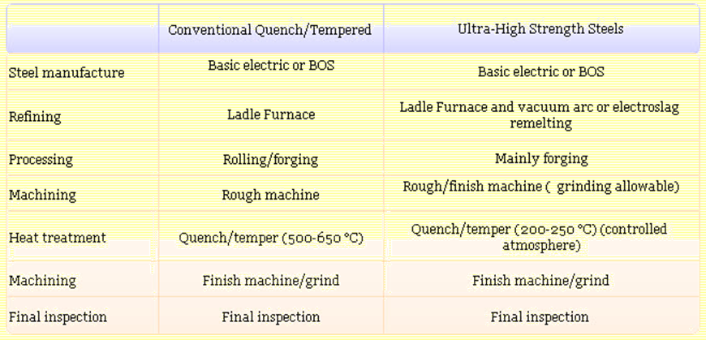
Processing of Ultra-High Strength Steels
Processing of ultra-high strength involves tighter disciplines than are normally adopted for lower strength direct hardening alloy steels.
Processing stages for ultra-high strength steels
RG

Slide 39
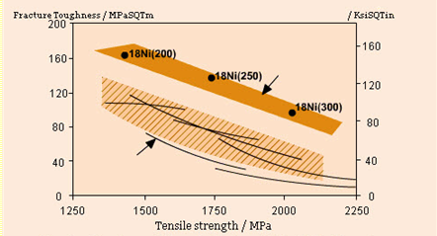

Maraging steels
Maraging steels are special ultra-high strength steels that achieve high levels of strength and toughness quite differently from conventional alloy steels. Whilst the structure is low carbon (lath) martensite, their high hardness and strength are produced by the precipitation of intermetallic compounds throughout the matrix.
Tensile strength
Fracture Toughness of Maraging Steels and Other High-Strength Martensitic Grades.
RG

Slide 40
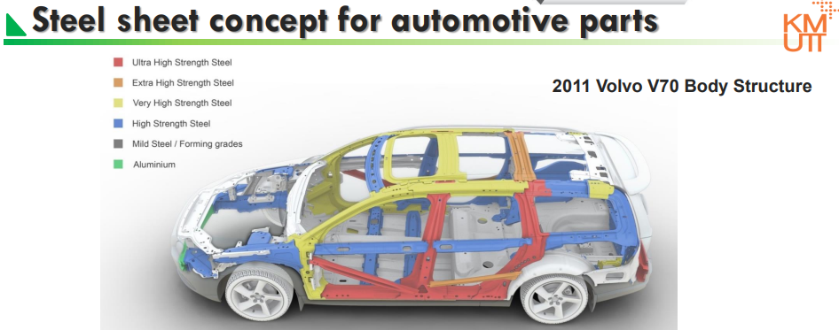

Slide 41
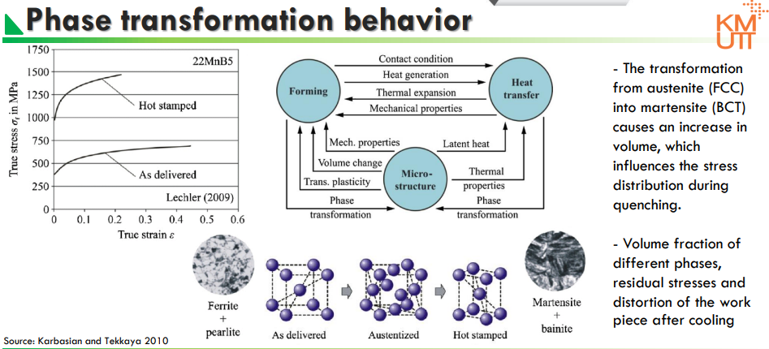

Slide 42
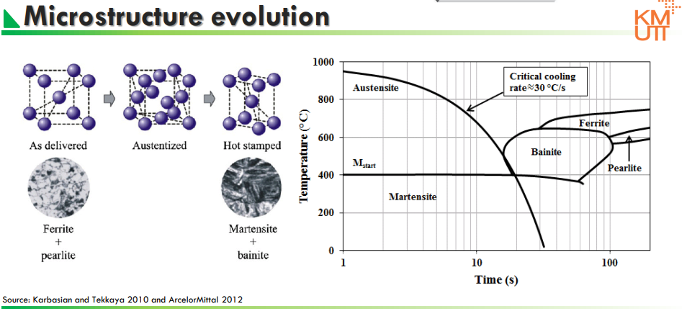

Slide 43
